Slide 1


CS101: Introduction to Computing Using the Autograder
Dr. Mohammad Nauman
Assistant Professor (CS), National University of Computer and Emerging Sciences
mohammad.nauman@nu.edu.pk
http://recluze.wordpress.com

Slide 2
Autograder URL
http://121.52.146.108:8000/

Slide 3
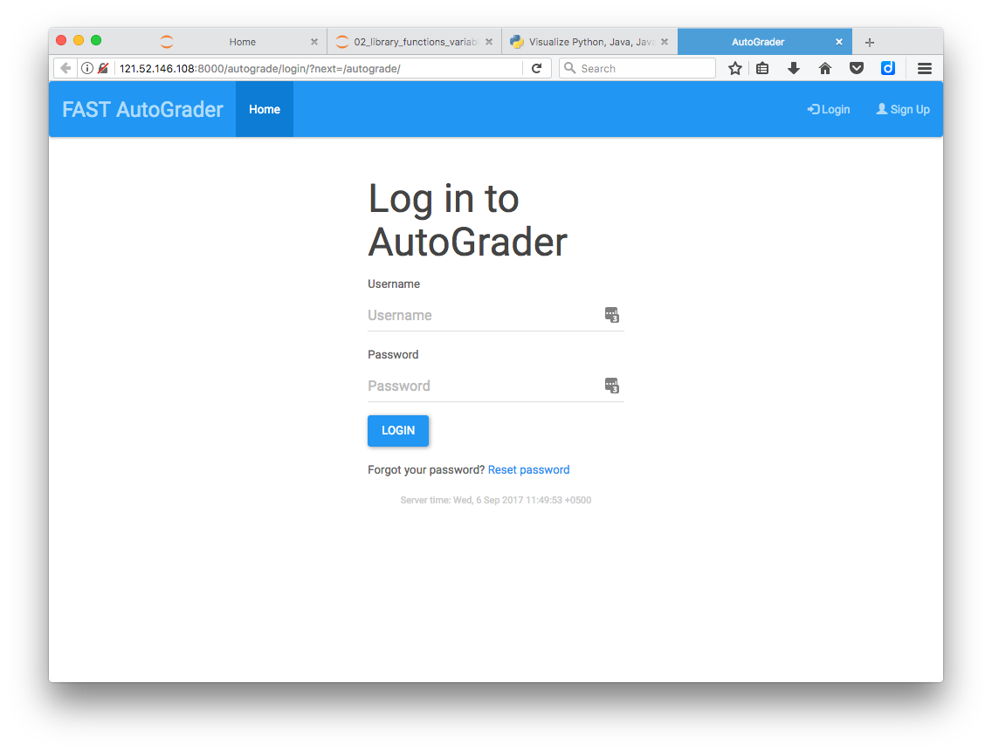

Slide 4
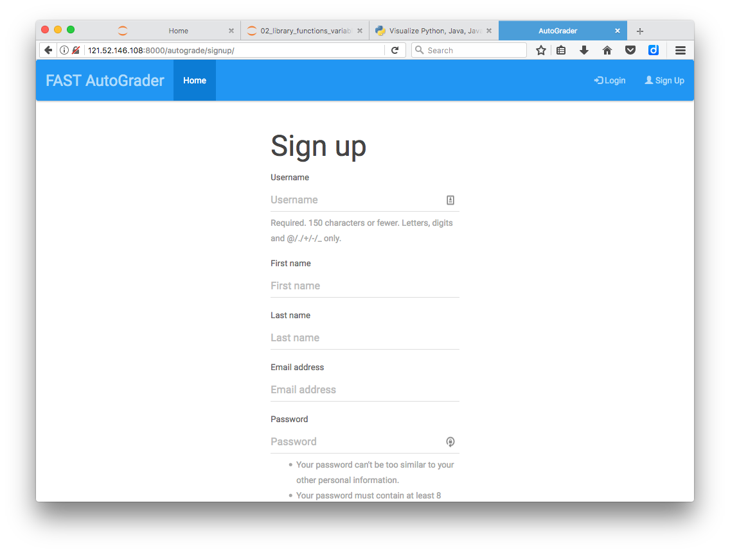

Slide 5
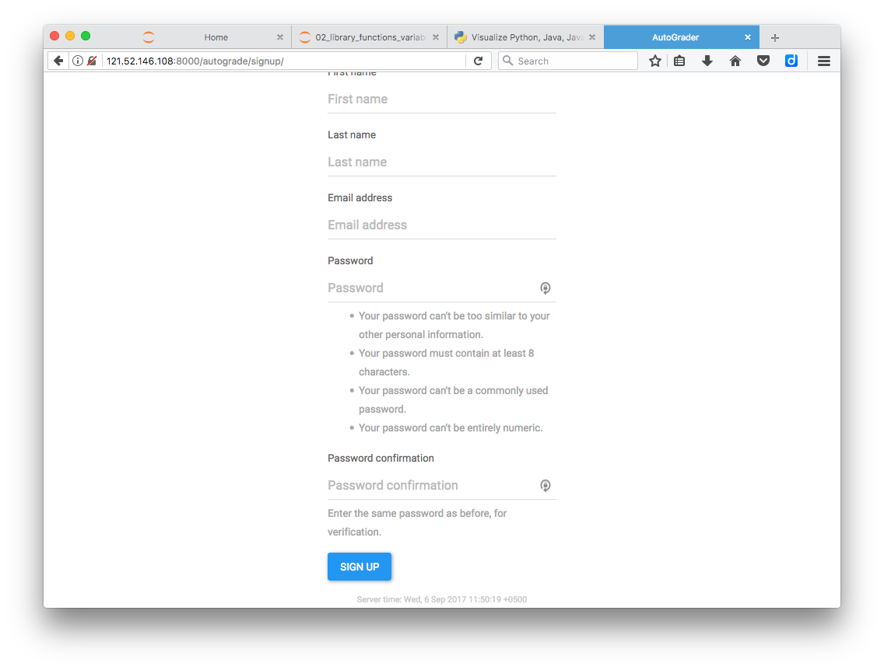

Slide 6
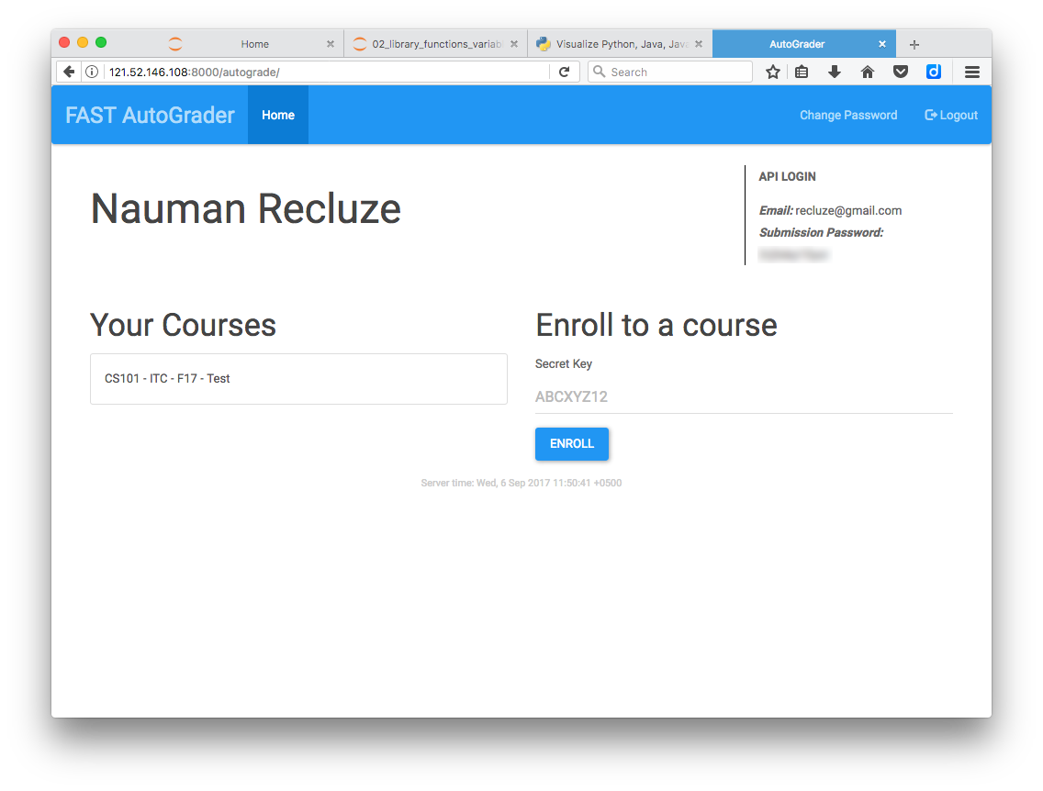

Slide 7
Enrollment Keys
Section A - NH2GB0
Section B - P6WDRB
Section C - 64E7LQ
Section D - DDPMKE

Slide 8
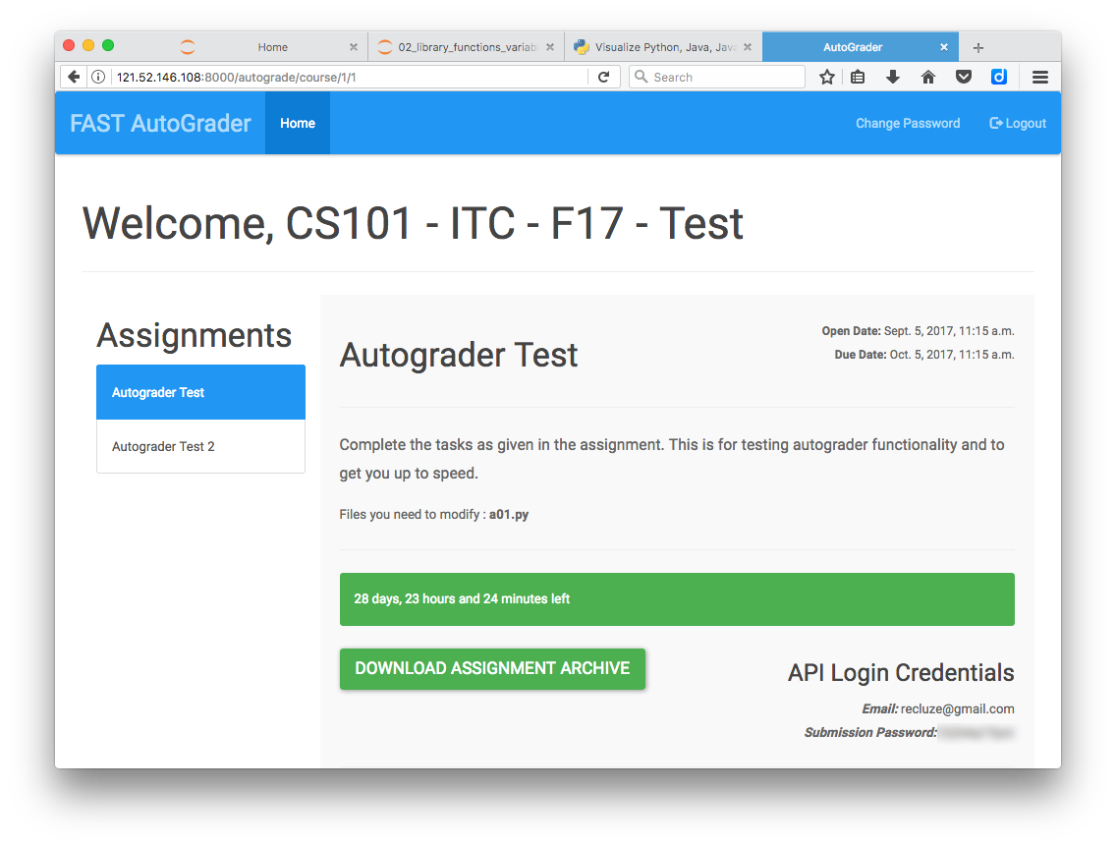

Slide 9
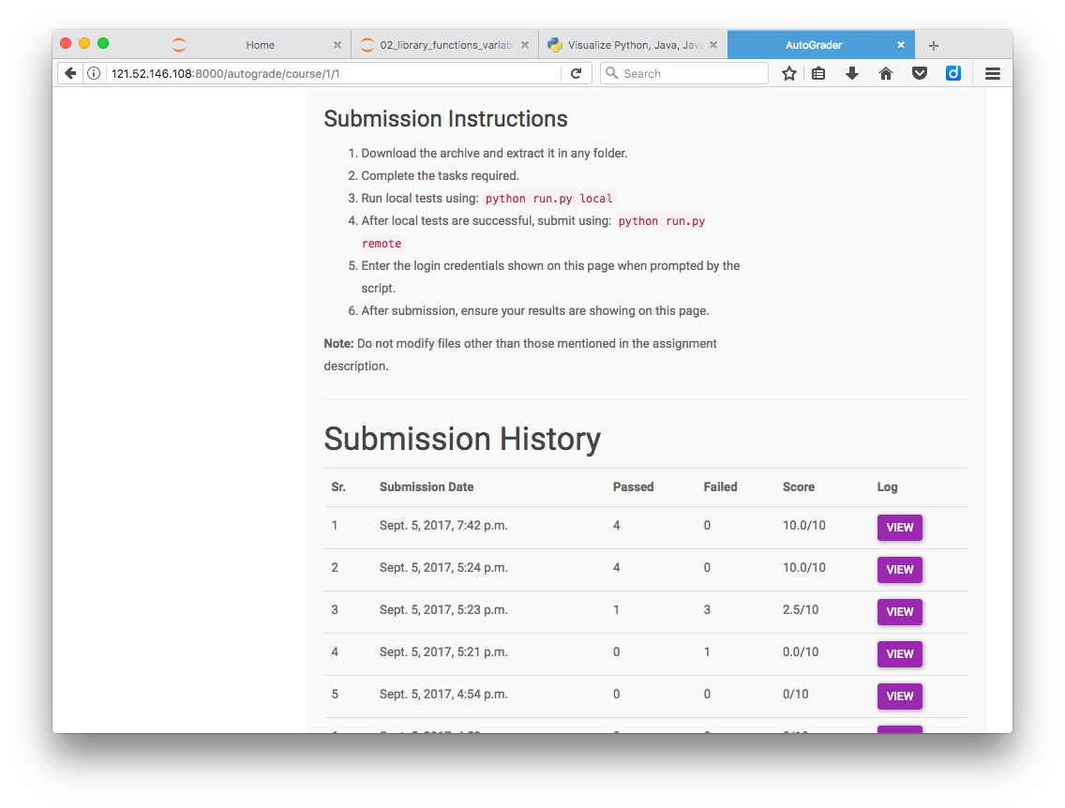

Slide 10
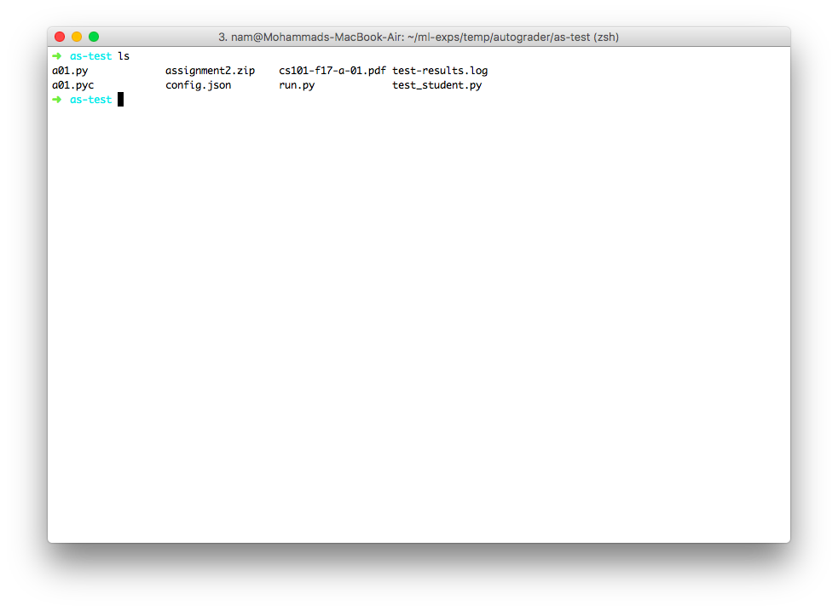

Slide 11
In Anaconda shell:
pip install pytest-timeout
(Only needed once.)

Slide 12
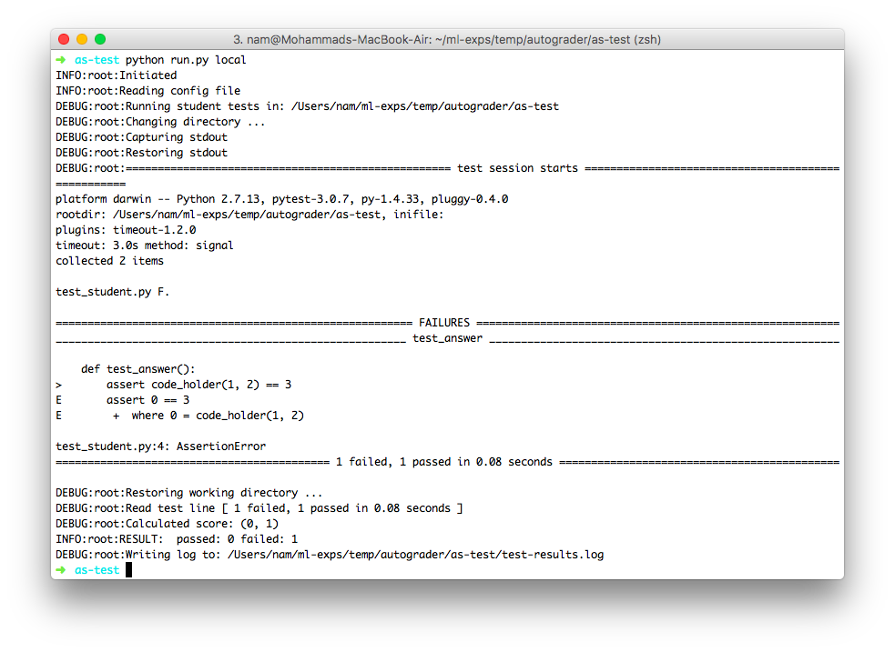

Slide 13
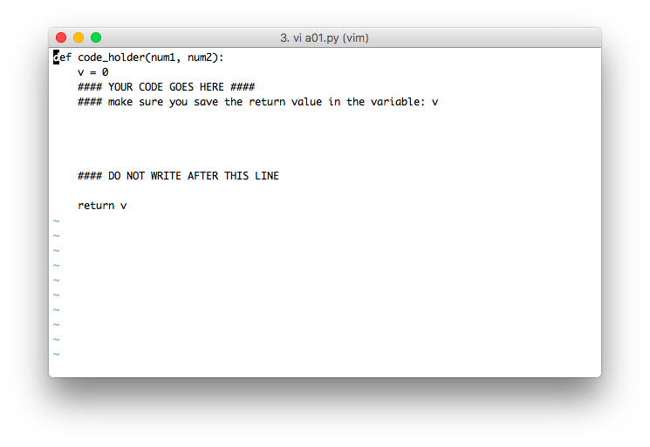

Slide 14
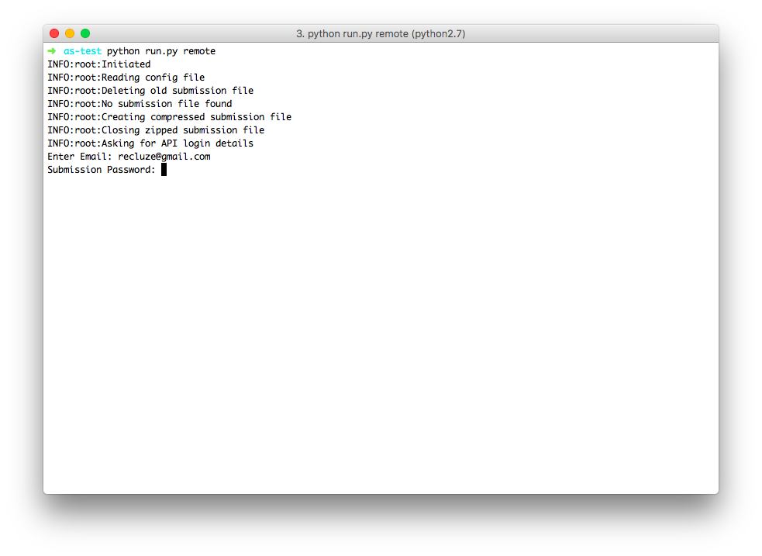

Slide 15
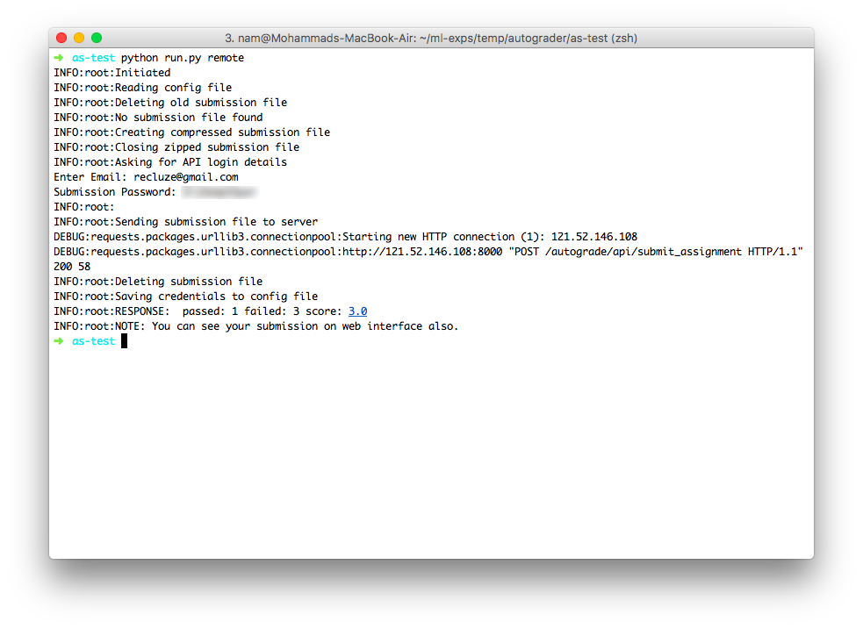

Slide 16
